Slide 1
Retail Sales
Andrew, Emerie, Samantha

Slide 2
Introducing
The Data
Store Features
Spans 2010-2013
Store
Date
Fuel price
Unemployment rate
*Company is unknown, but 45 stores are included

Slide 3
Introducing The Data - Sales
Spans 2010
Store
Weekly sales
Stores can lose money in a given week
Date
Somewhat random - Feb 4 and Feb 7 on different ‘weeks’
IsHoliday (True/False)
Also somewhat random, more detail later

Slide 4
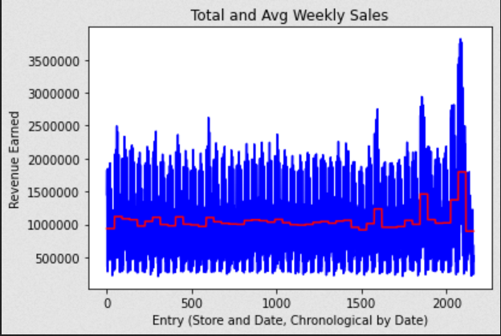
Weekly Sales vs Average Sales

Slide 5
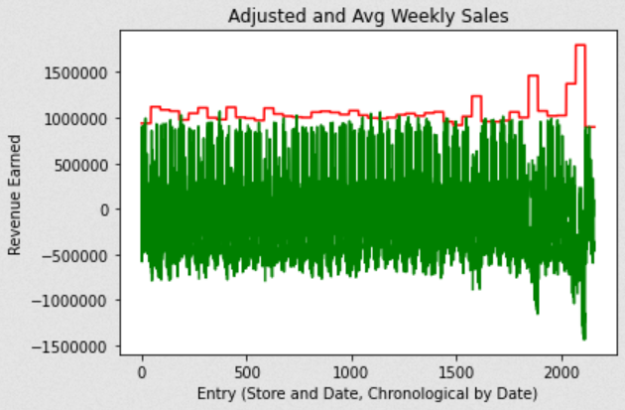
Adjusted Weekly Sales vs Avg Sales
Weekly sales - avg sales
= adjusted sales

Slide 6
How do holidays have an effect on retail sales?

Slide 7
Which holidays are present?
Oct 9 - Columbus Day
Nov 26 - Thanksgiving
Dec 2 - ???
Dec 31 - New Year’s Eve
Dec 24, Christmas Eve, is not
Dec 2 is listed as holiday while Dec 3 isn’t

Slide 8
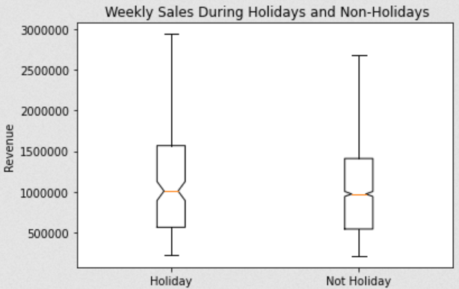
Holidays and Weekly Sales
Holidays had more outliers with big revenue
Ignoring outliers, holidays and non-holidays had similar sales

Slide 9
How does unemployment have an effect on retail sales?

Slide 10
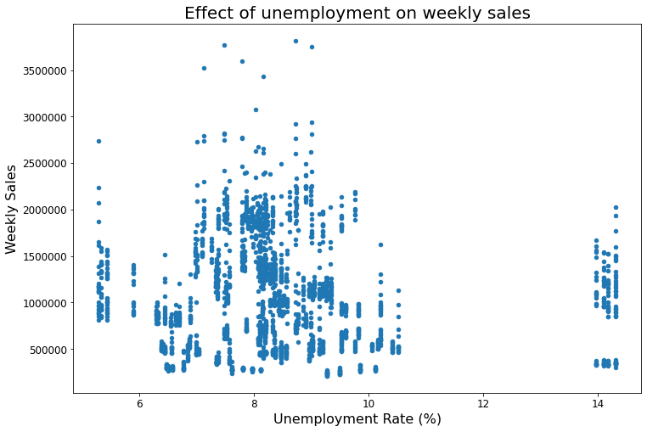
Unemployment vs. Weekly Sales
Greatest weekly sales observed between 8-9%
General trend is not very clear
Notes:
When unemployment rate is under 11%, weekly sales are between $10,000-20,000
There appears to be an increase in weekly sales when unemployment is between ~7-9%
When unemployment is at 14%, weekly sales increase to around average
This graph gives a slight trend but it could be clearer
7.175463e-03 r^2

Slide 11
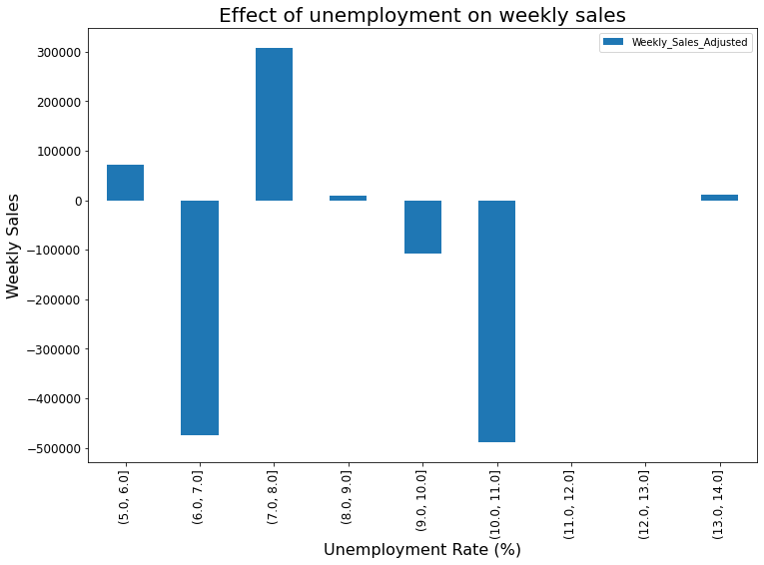
Unemployment vs. Adjusted Weekly Sales
High variation
Majority of sales occur when unemployment is between 7% and 8%
Notes:
This graph shows a clearer trend when looking at the adjusted weekly sales showing how far above or below average weekly sales at each unemployment rate
At the lowest unemployment rate sales are about 10,000 above average but dips significantly below average when increasing by 1%
Sales increase between 7-8% unemployment then significantly decrease to 10% unemployment
7.614562e-03 r^2

Slide 12
Why would weekly sales appear to increase if unemployment is higher?
Potentially due to inflation
However, in there is weak relationship between CPI and unemployment
Notes:
The sales increase at 14% could be an outlier due to other confounding variables such as temperature and markdowns
If the temperature is uncomfortable, consumers may be less likely to go out and buy goods
If unemployment rate is very high, then stores may be more likely to increase markdowns in order to make their products more affordable so they will increase sales
0.000597 r^2 with outliers removed

Slide 13
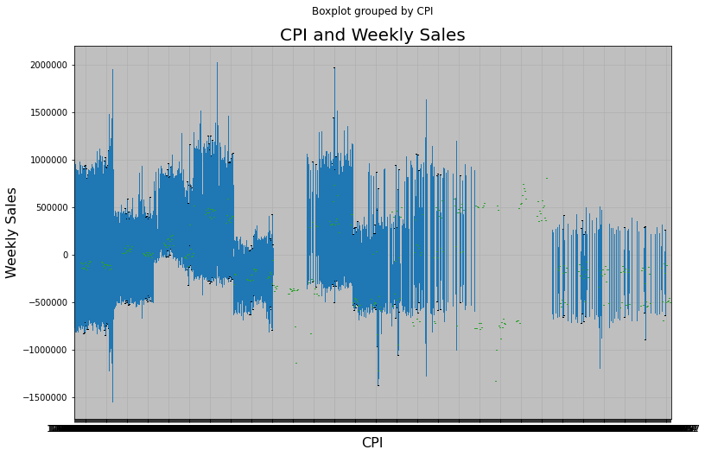
Inflation and retail sales
Weak relationship between CPI and unemployment (correlation is 0.124352)

Slide 14
How do fuel prices have an effect on retail sales?

Slide 15
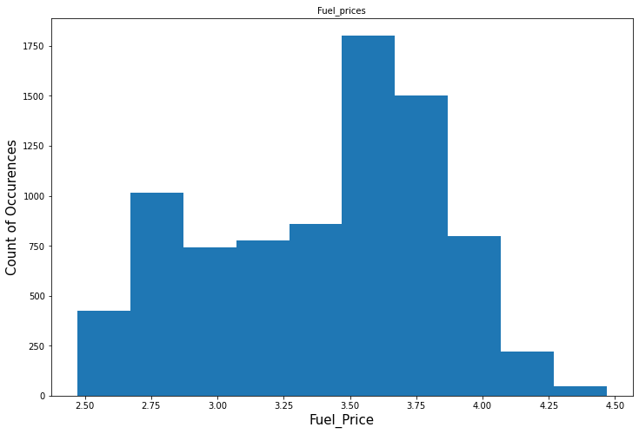
Distribution of Fuel prices
Mean Fuel Price: $3.41
Median Fuel Price: $3.51
Max Fuel Price: $4.47
Min Fuel Price: $2.47
Unique Fuel Prices: 1011

Slide 16
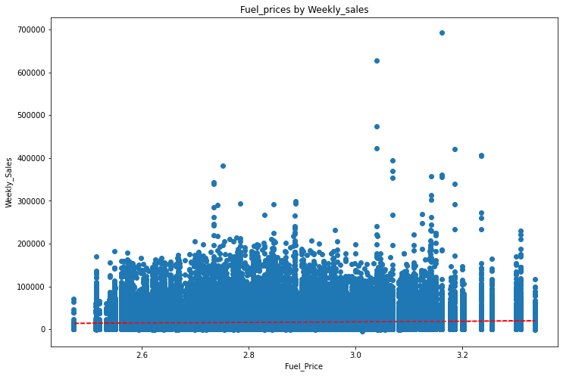
Fuel Prices vs Weekly Sales
Weekly sales are very similar based on fuel prices
More consistent sales happen when the fuel price is below $3.2

Slide 17
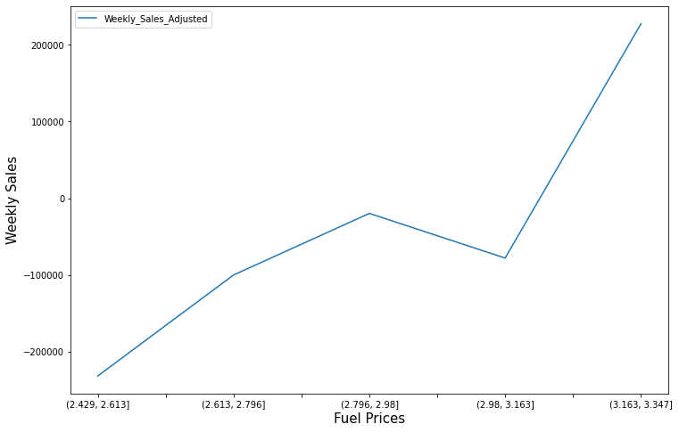
Fuel Price vs Adjusted Weekly Sale
Upward trend when fuel prices increase so do Adjusted Weekly Sales

Slide 18
What combination of the above factors (holidays, fuel price and unemployment) lead to the best sales weeks? The worst?

Slide 19
Step 1: Thinking About Correlation
Fuel prices and weekly sales had a slight correlation of 0.03 (not adjusted), 0.075(adjusted)
Unemployment and weekly sales had a slight correlation of 0.0007 (not adjusted), 0.0008 (adjusted), and 0.0006 (removed outliers)
IsHoliday boolean can’t generate a correlation, but the status doesn’t appear to have a major relationship with weekly sales
Independently, these variables don’t have significant effect on sales

Slide 20
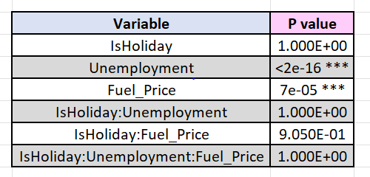
Step 2: Combining variables with ANOVA
No significant relationships between variables

Slide 21
Main Takeaways
The above factors (Fuel Price, Holidays, Unemployments) didn’t have a strong effect on Weekly Sales
Missing information on what kind of stores, what is sold, etc, would help to gain better insight

Slide 22
Thank you!

Slide 23
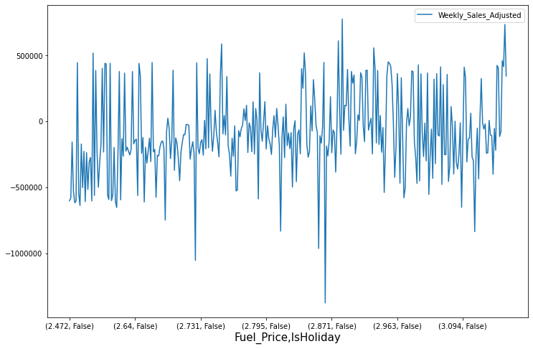

Slide 24
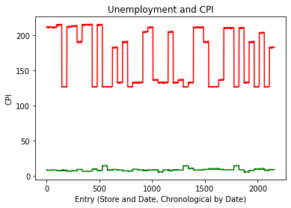

Slide 25
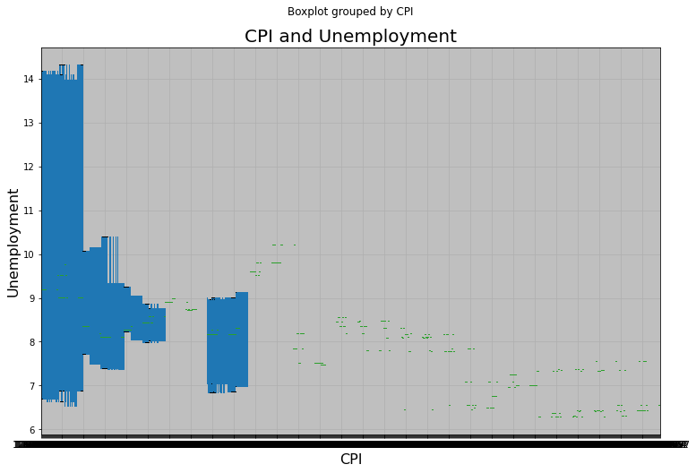

Slide 26
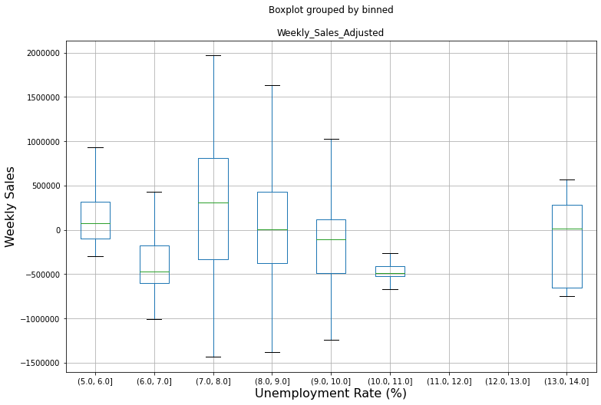

Slide 27
